Slide 1





Azure Solutions Architect – PaaS
Scan this QR-code to access free resources, step-by-step learning guides as well as get practical experience in Azure Architecture - PaaS!
https://aka.ms/AA8x968
Don’t forget to add Microsoft Azure as a skill to your LinkedIn account to stay connected with a developer community!
+ Microsoft Azure
We post the latest announcements about free events for developers in Ireland on our official Twitter account!
@MSDevIRL

Slide 2
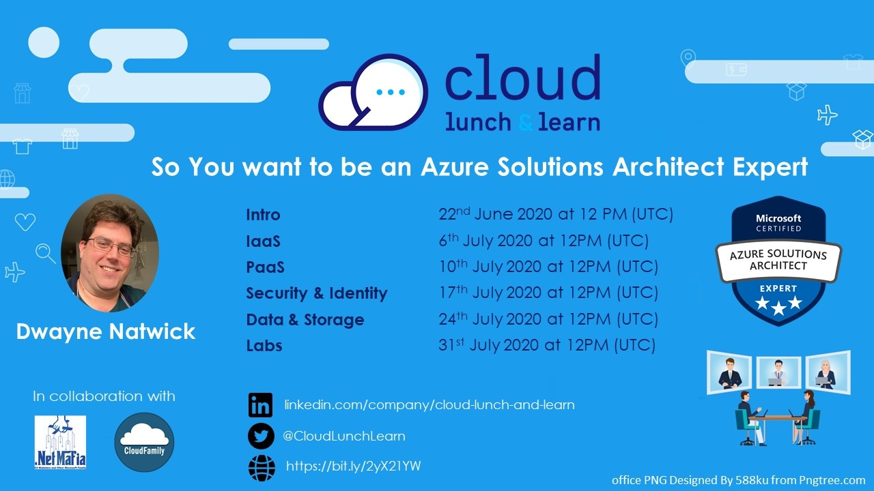

Slide 3
SO YOU WANT TO BE AN AZURE ARCHITECT EXPERT
PaaS objectives
Notes:
Thank you for joining this Cloud lunch and learn session. I’m going to speak to you today about Azure Certifications and Becoming a certified Azure Developer Associate

Slide 4




ABOUT THE AUTHOR
I am an author, trainer, and product manager with over 30 years of experience in the IT industry. I am a CISSP, PMP, and certified in multiple Azure and M365 roles, including Solution Architect Expert, Administrator Associate, and Security Engineer Associate.
In addition to creating curriculum, training, public speaking, and blog writing, I am also a Microsoft Certified Trainer and Regional Lead.
You can find me on social media at:
https://captainhyperscaler.com
http://linkedin.com/in/dnatwick
@DwayneNcloud
Dwayne Natwick
Sr. Cloud Training Architect
CISSP, PMP, 9x Azure/M365 Certified
MCT Regional Lead
Notes:
My name is Dwayne Natwick and I will be your instructor for this course. I am an author, trainer, and product manager that has been in the IT industry for over 30 years. I currently have multiple Azure and 365 role-based certifications along with my CISSP and PMP.​
​
I am a Microsoft Certified Trainer and a Regional Lead for the program. You can find me active on social media at the links provided on the slide.​

Slide 5

AZURE SOLUTIONS ARCHITECT EXPERT OBJECTIVES AND KEY AREAS
Azure Solutions Architect Expert certification objectives were adjusted earlier this year
Exam numbers will be changing
  AZ-300 retires on September 30, 2020, replaced by AZ-303 (beta June 29)
  AZ-301 retires on September 30, 2020, replaced by AZ-304 (beta June 29)
Passing both exams will award you with the Azure Solution Architect Expert certification (good for two years)
Objective areas by exam
  AZ-300/AZ-303: https://query.prod.cms.rt.microsoft.com/cms/api/am/binary/RE3VzwB
  AZ-301/AZ-304: https://query.prod.cms.rt.microsoft.com/cms/api/am/binary/RE3VEHD

Slide 6
MICROSOFT AZURE ARCHITECT TECHNOLOGIES (300/303 EXAM)
Objective areas:
  Deploy and configure infrastructure (40-45%)
  Implement workloads and security (25-30%)
  Create and deploy apps (5-10%)
  Implement authentication and secure data (5-10%)
  Develop for the cloud and for Azure storage (15-20%)
Very closely aligned to the AZ-104 exam
Long exam, one of the few that could take up the entire time

Slide 7
MICROSOFT AZURE ARCHITECT DESIGN (301/304 EXAM)
Objective areas:
  Determine workload requirements (10-15%)
  Design for identity and security (25-30%)
  Design a data platform solution (15-20%)
  Design a business continuity strategy (15-20%)
  Design for deployment, migration, and integration (10-15%)
  Design an infrastructure strategy (15-20%)
More design focus with case studies
Databases
Azure Site Recovery
Azure Migrate

Slide 8
PAAS TOPICS
Azure App Service
Logic Apps
Azure Functions
Azure Kubernetes Service
Cosmos DB
Azure SQL Database
Other Microservices (Event Grid, Event Hub, Service Bus, Queues, Cognitive Services, webhooks)
Notes:
This discussion is going to provide you with guidance on determining a certification path and building your certification roadmap, preparing for an exam, including some learning resources to use in your preparation.
We will then go through a high level overview of the Azure Developer Associate exam, and the objectives and key areas that are covered on this exam.
We will finish up with the next steps to take in building your path to passing the Azure Developer Associate exam.

Slide 9

AZURE APP SERVICES
Pricing options
  Single instance
    Free
    Shared
  Multi-instance
    Basic (up to 3)
    Standard (up to 10)
    Premium (up to 30)
    Isolated (up to 100)
Custom domains support at Shared level up
Auto scaling from Standard level up
Network isolation only on Isolated subscription
Windows or Linux compatible
Languages supported:
  Node.js
  ASP.NET or .NET core
  PHP
  Java
Containerized web apps
https://docs.microsoft.com/en-us/azure/app-service/

Slide 10

LOGIC APPS
Create a graphical workflow Azure
Orchestrate tasks
Automate actionable tasks from triggered conditions
Integrates with services inside and outside of the Microsoft ecosystem
https://docs.microsoft.com/en-us/azure/logic-apps/

Slide 11

AZURE FUNCTIONS
Functions are small pieces of code that execute on a trigger
Languages: C#, Java, JavaScript, Python, and PowerShell
Pay per use on consumption (Premium and App Service plans available)
Functions can be run through GitHub open source repositories
Work with a variety of services to trigger and initiate workflow:
  HTTP
  Timer
  Cosmos DB
  Blob and Queue storage
  Event Grid
  Event Hub
  Service Bus Queue
  Service Bus Topic
https://docs.microsoft.com/en-us/azure/azure-functions/functions-overview

Slide 12


AZURE KUBERNETES VS. CONTAINER INSTANCES
Azure Kubernetes Service
  Full container orchestration
  Services across multiple containers
  Auto-scaling
  Coordinated application upgrades
Azure Container Instance
  Isolated container
  Simple applications
  Task automation
  Creating a container image
https://docs.microsoft.com/en-us/azure/aks/intro-kubernetes
https://docs.microsoft.com/en-us/azure/container-instances/container-instances-overview

Slide 13

AZURE SQL DATABASE
Fully managed PaaS
Microsoft does all management and patching OS-down, with built-in:
  Upgrades
  Updates
  Patching
  Backups
  Monitoring
99.99% availability
vCore or DTU purchasing models
Other SQL options: SQL Virtual Machine or Managed SQL Instance
https://docs.microsoft.com/en-us/azure/azure-sql/database/sql-database-paas-overview

Slide 14

COSMOS DB
Globally distributed database service
APIs for SQL, MongoDB, Cassandra, Tables, or Gremlin
Scales throughput and storage at Azure regions worldwide
99.999% availability on read and writes
Multiple consistency levels (understand the pros and cons):
  Strong
  Boundless Staleness
  Session
  Consistent Prefix
  Eventual
https://docs.microsoft.com/en-us/azure/cosmos-db/consistency-levels
https://docs.microsoft.com/en-us/azure/cosmos-db/introduction

Slide 15





OTHER PAAS AND MICROSERVICES
Event Grid
Event Hub
IoT Hub
Service Bus
  Queues
  Tables
Cognitive services
https://docs.microsoft.com/en-us/azure/architecture/microservices/

Slide 16
PAAS DEMO
App Services, Logic Apps, Databases

Slide 17
NEXT STEPS
Take your self assessment
Microsoft Learn
Microsoft Docs
Create an Azure account for hands-on
Reach out with any questions or additional guidance
Future sessions on specific objective areas (schedule on next slide)
https://build5nines.com/free-oss-exam-self-assessment-tool/
Notes:
What should you do now.
I suggest that you start by downloading and taking the self assessment on the Azure Developer Associate exam.
Start to review the information in Microsoft docs, and take the Learning path in Microsoft Learn.
Create an Azure account for hands-on and also download Docker.
Feel free to reach out to me with any questions or additional guidance. If you would like specific objective areas to be covered in more detail, we may be able to provide sessions in the future with deeper dive into these objectives.

Slide 18
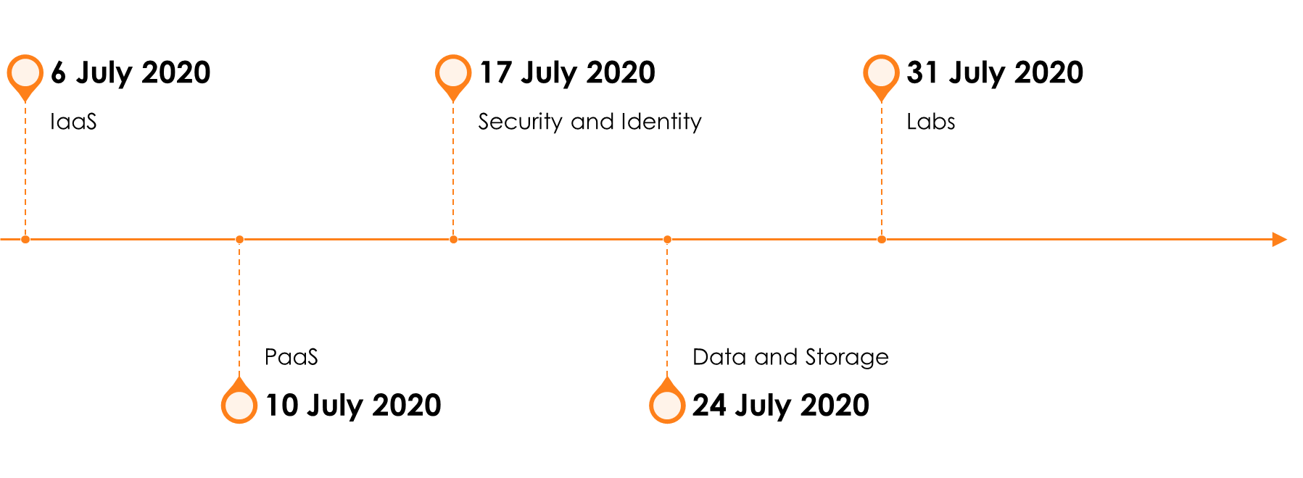
SO YOU WANT TO BE AN AZURE ARCHITECT EXPERT PREP SERIES

Slide 19
Azure Solutions Architect – PaaS
Scan this QR-code to access free resources, step-by-step learning guides as well as get practical experience in Azure Architecture - PaaS!
https://aka.ms/AA8x968
Don’t forget to add Microsoft Azure as a skill to your LinkedIn account to stay connected with a developer community!
+ Microsoft Azure
We post the latest announcements about free events for developers in Ireland on our official Twitter account!
@MSDevIRL

Slide 20
THANK YOU!
You can find me on social media at:
https://captainhyperscaler.com
http://linkedin.com/in/dnatwick
@DwayneNcloud
Notes:
Thank you for your time today. Feel free to reach out to me at any of the links on the screen.

